Slide 1
Make Your PowerPoints Evidence-Based
RIME Workshop 2015
Terry Shaneyfelt, MD, MPH
Division of General Internal Medicine
@EBMTeacher
EBMTeacher.com

Slide 2
Objectives
Participants will be able to summarize the cognitive theory of multimedia learning
Given examples of slides with various design flaws participants will:
  recognize those elements violating the CTOMML
  correctly redesign slides to maximize retention and transfer of knowledge

Slide 3
Cognitive theory of multimedia learning
When presented with a multimedia lesson the graphics and printed words enter our cognitive processing system through our eyes and spoken words enter through our ears. Next, the learner selects key words and images for further processing in working or short-term memory. Next, the selected words and images are organized into a verbal and pictorial model or representation. Finally, these models are integrated with each other and with existing knowledge from long-term memory.

Slide 5
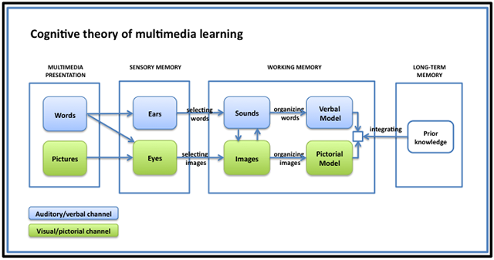
When presented with a multimedia lesson the graphics and printed words enter our cognitive processing system through our eyes and spoken words enter through our ears. Next, the learner selects key words and images for further processing in working or short-term memory. Next, the selected words and images are organized into a verbal and pictorial model or representation. Finally, these models are integrated with each other and with existing knowledge from long-term memory.

Slide 7
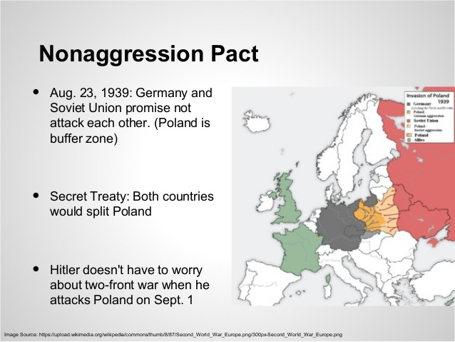

Slide 9
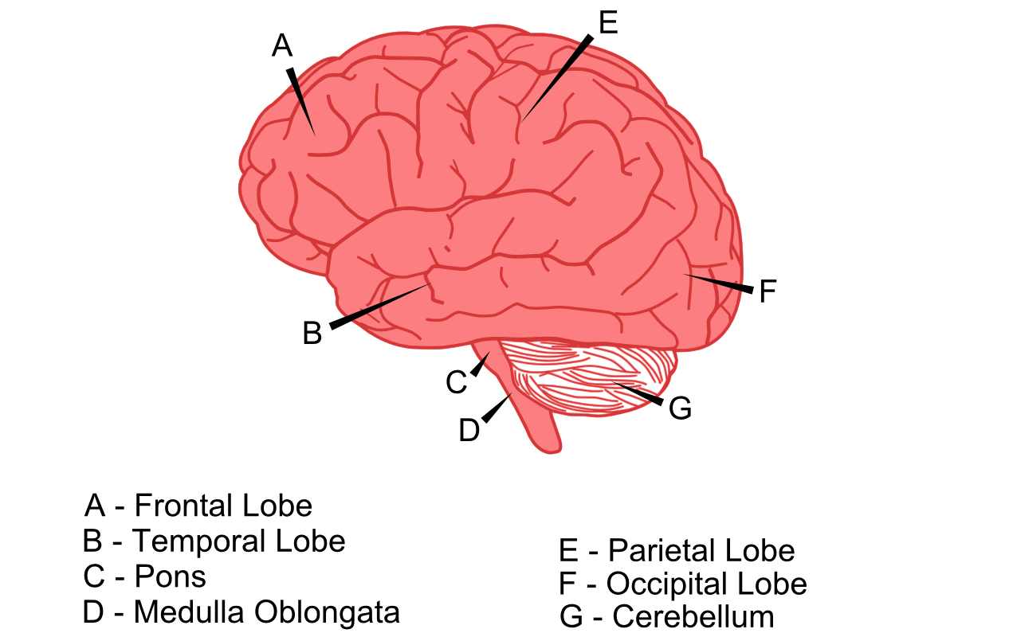
Anatomy of the brain
From: https://sites.google.com/site/cognitivetheorymmlearning/home

Slide 11
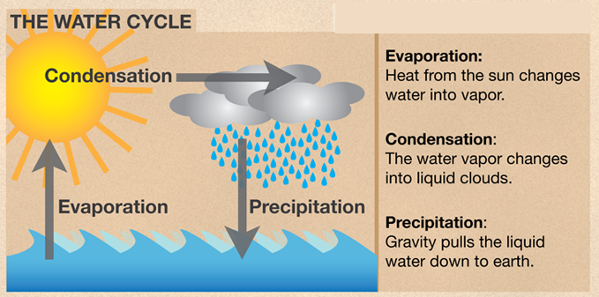
What makes it rain?

Slide 13
How the heart works-1
Right Side of the Heart
  Blood enters the heart through the inferior and superior venae cavae emptying oxygen-poor blood into the right atrium of the heart.
  As the atrium contracts, blood flows from your right atrium into your right ventricle through the open tricuspid valve.
  When the ventricle is full, the tricuspid valve shuts. This prevents blood from flowing backward into the atria while the ventricle contracts.
  As the ventricle contracts, blood leaves the heart through the pulmonic valve, into the pulmonary artery and to the lungs, where it is oxygenated and then returns to the left atrium through the pulmonary veins.
Left Side of the Heart
  The pulmonary veins empty oxygen-rich blood from the lungs into the left atrium of the heart.
  As the atrium contracts, blood flows from your left atrium into the left ventricle through the open mitral valve.
  When the ventricle is full, the mitral valve shuts. This prevents blood from flowing backward into the atrium while the ventricle contracts.
  As the ventricle contracts, blood leaves the heart through the aortic valve, into the aorta and to the body.

Slide 14
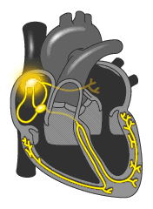
How the heart works-2

Slide 16
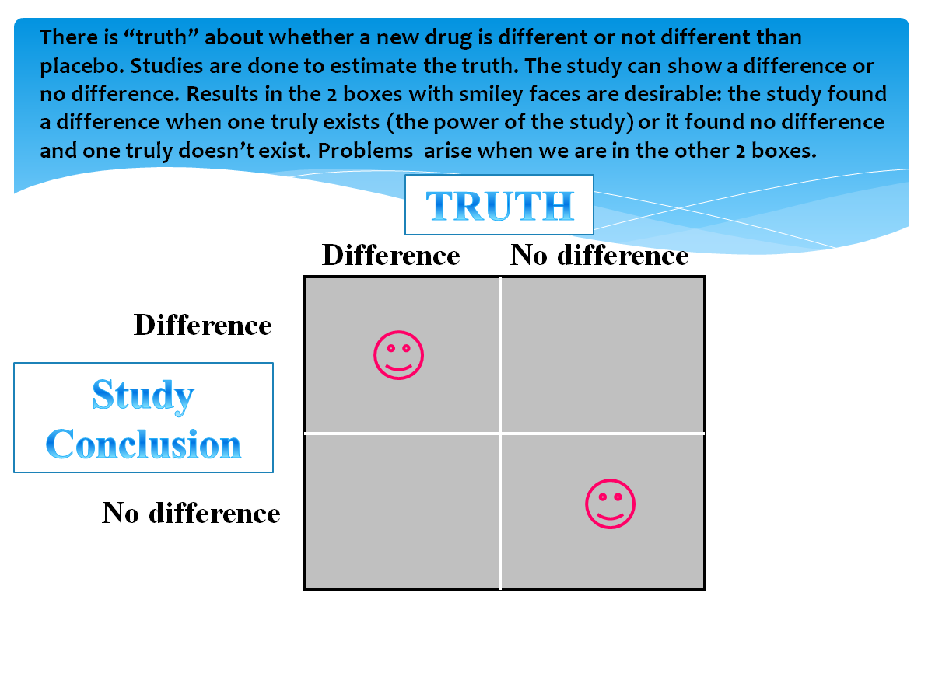

Slide 18
What causes an airplane to take off?
The curved upper surface of the wing is longer than the flatter bottom surface.
Air moves across the top of the wing faster than the bottom.
Air pressure on the top of the wing is less than the bottom. As air moves faster, its pressure decreases. Since there is greater pressure exerted on the bottom, lift is created.

Slide 20
Take home points
Multimedia principles are evidence-based
Contiguity principles have greatest impact
Redundancy and coherence also have significant impact

